Slide 1

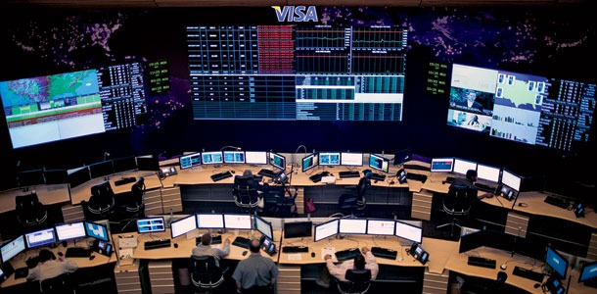

THE SECURE!
Presented by:
-Shivaprakash
-Sahana
-Sourabh
-Mrudula jain

Slide 2

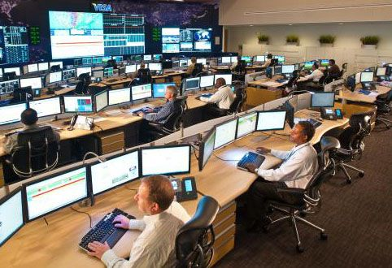

INTRODUCTION to visa their SECURITY precautions AND OPERATIONAL CENTER EAST.
VISA Established
September 1958
OPERATION
CENTER EAST
ABOUT
130 WORKERS
What is OCE?
DATA CENTER
OH DID I MENTION IT
HAS MOAT??
RISK MANAGEMENT
INFORMATION
SERVICES
FRAUD MONITORING
ENCRYPTION
CTO
Matt Quinlan
Inside the pods, 376 servers,
277 switches, 85 Routers
and 42 firewalls all connected by
3,000 miles of Cable--hum around
the clock, enabling transactions
around the globe in near real-time
and keeping Visa's business running.
CAPACITY

Slide 3
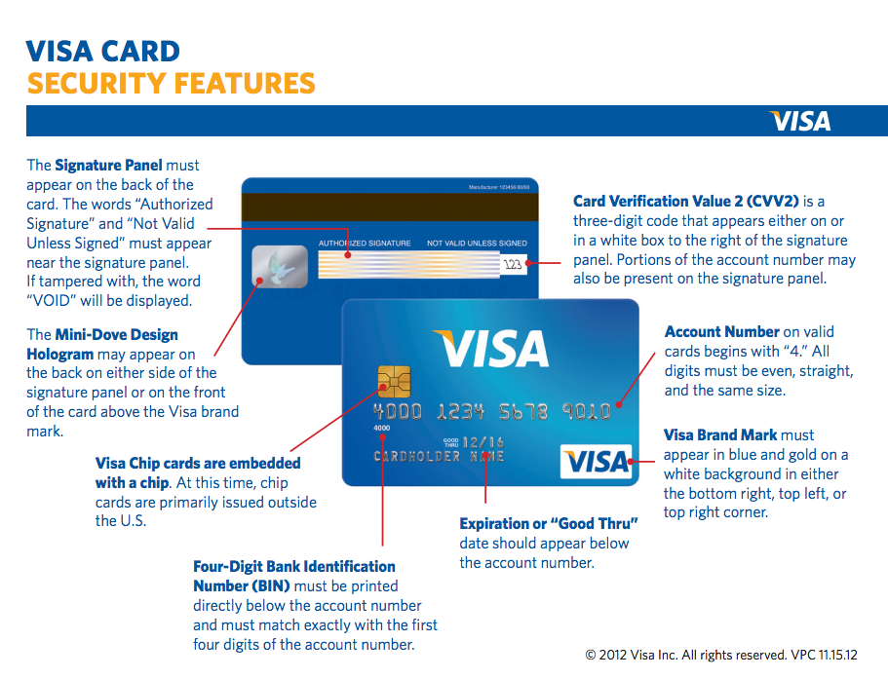
PROTECTION / SECURITY
HOW?
Location Unknown!
OCC BACKUP
LEED CERTIFIED
.
“The speed of light is no longer fast enough”
- CTO Matt Quinlan
Somewhere along
the Eastern seaboard
Diesel Power
(Almost 15 days)
1.5 million gallons
of water As coolant

Slide 4

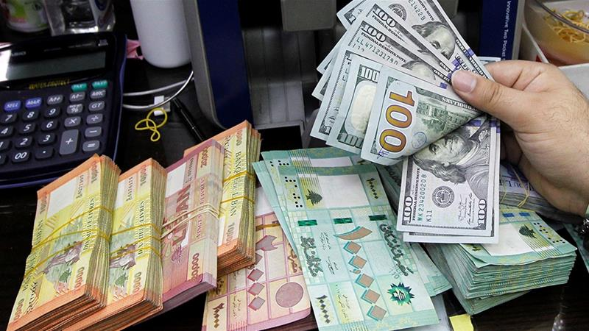

BLACK MARKET , underground economy or shadow economy!
Operations in black marketing
Background economy
The illegal economy
The unreported economy
The unrecorded economy
The informal economy

Slide 5
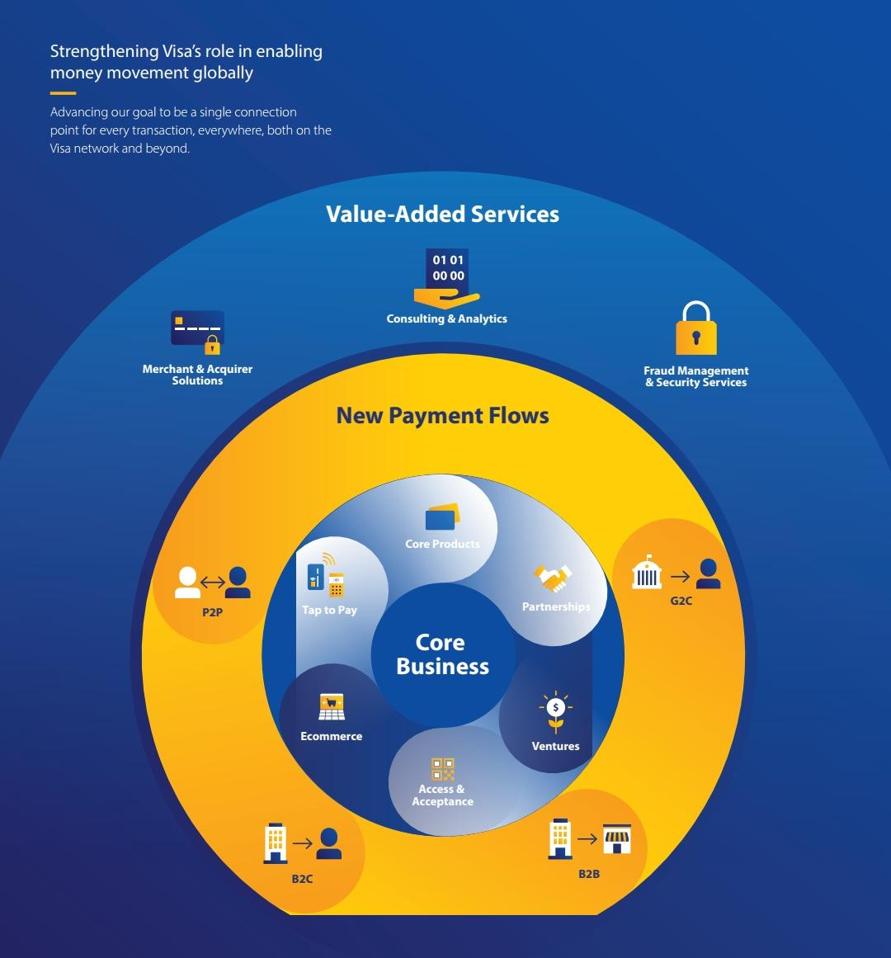
PRODUCT DISTRIBUTION AND VISA TRANSACTIONS

Slide 6

Hackers and prevention from hacking
Professional organized
crime-modeled
hacker gangs
WHO
Skimming, Account
enumeration,
Combination attacks
How?
How to prevent (By visa)?
Visa introduced three new tools
i.Visa Vital Signs
ii.Visa Account Attack Intelligence
iii.Visa Payment Threat Lab and
eCommerce Threat Disruption

Slide 7
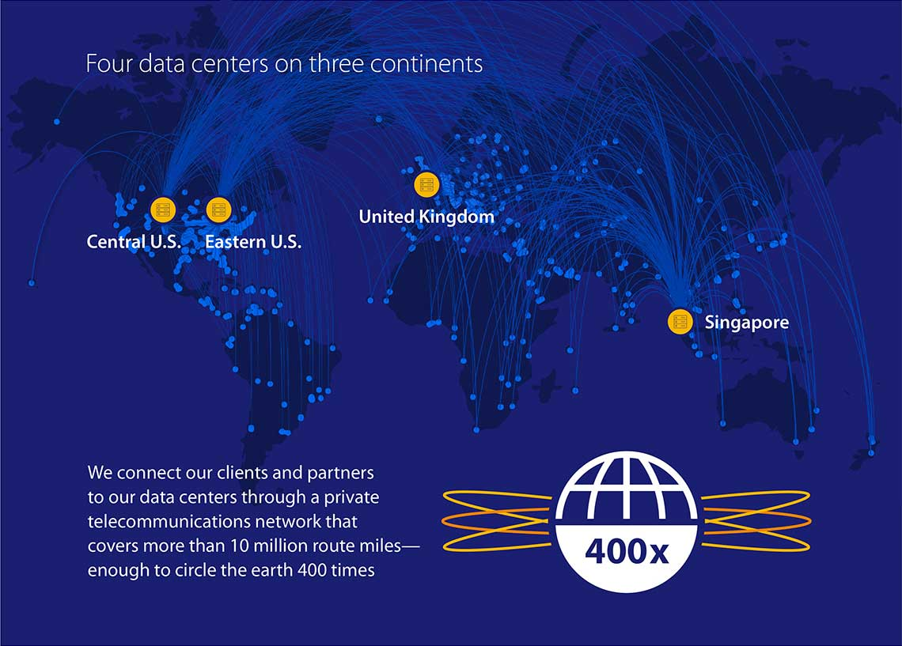
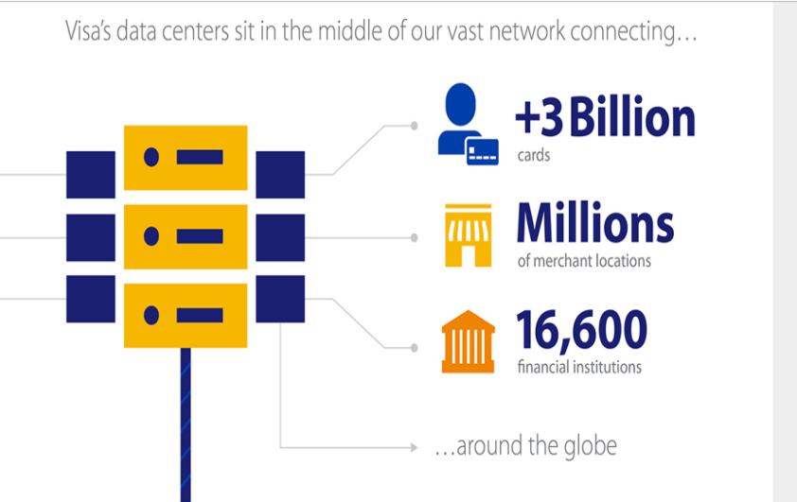

DATA CENTRE MANAGEMENT during natural disasters and controlling them.

Slide 8
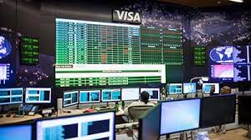
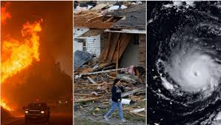

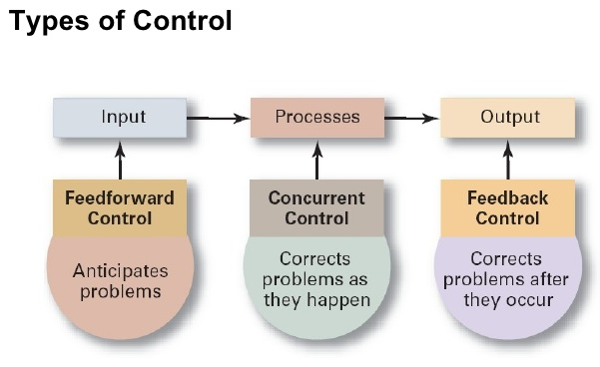

Slide 9
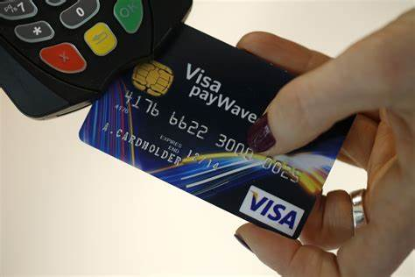
Visa’s goal is simple, they ensure and promise that every transaction is processed quickly, securely, seamlessly and at last ultimately people’s money is safe.
"It's everywhere you want to be"

